Slide 1
Electronic Devices
Final Term Lecture - 02
Reference book:
Electronic Devices and Circuit Theory (Chapter-5)
Robert L. Boylestad and L. Nashelsky , (11th Edition)

Slide 2
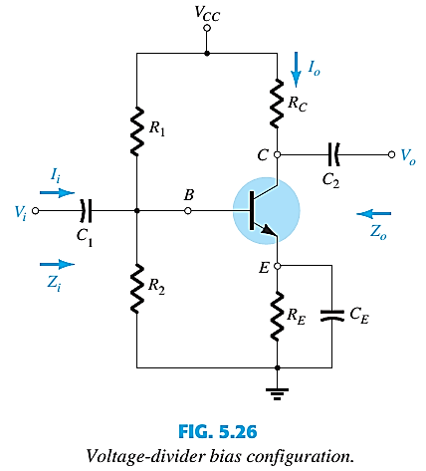
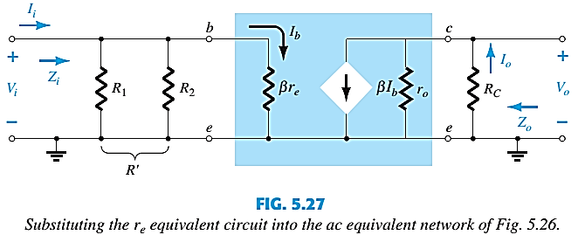
COMMON-EMITTER VOLTAGE-DIVIDER BIAS

Slide 3
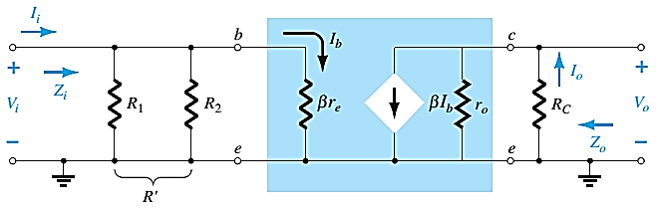







COMMON-EMITTER VOLTAGE-DIVIDER BIAS
INPUT IMPEDANCE, Z_{i}
$R^{′}= R_{1}‖$ $R_{2}$
$Z_{i}=R^{′}$ $‖$β$r_{e}$
OUTPUT IMPEDANCE, Z_{o}
VOLTAGE GAIN, A_{v}
$Z_{o}= R_{C}‖$ $r_{o}$
$V_{o}= {−\text{β}I_{b}(R}_{C}‖$ $r_{o})=−\text{β}\text{(}\frac{V_{i}}{\text{β}r_{e}}$)${ (R}_{C}‖$ $r_{o});$
$$I_{b}= \frac{V_{i}}{\text{β}r_{e}}$$
$Z_{o}≅ R_{C}$|$r_{o}≥10R_{C}$
$A_{v}= \frac{V_{o}}{V_{i}}$ = - $\frac{{ (R}_{C}‖ r_{o})}{r_{e}}$, ${ A}_{v}$= - $\frac{{ R}_{C}}{r_{e}} |r_{o}≥10R_{C}$

Slide 4
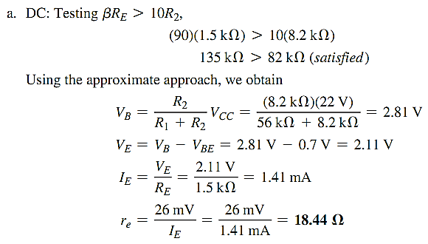
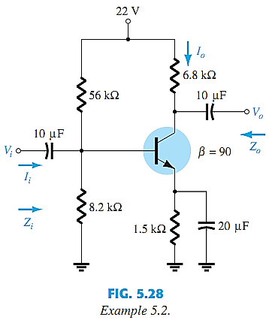
EXAMPLE
EXAMPLE 5.2: For the network of Fig. 5.28 :
Determine r_{e}, Z_{i}, Z_{o} (with r_{o} = ∞), A_{v} (with r_{o} = ∞) and Repeat with r_{o} = 50 kΩ.

Slide 5
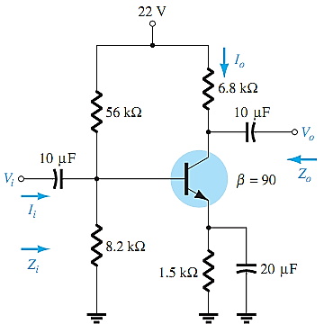
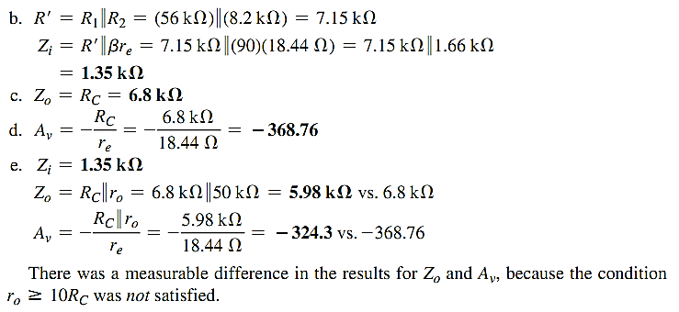
EXAMPLE Contd.

Slide 6
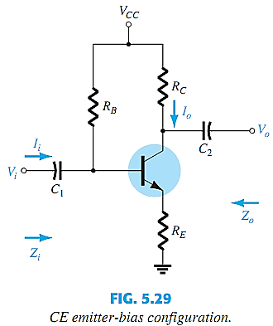
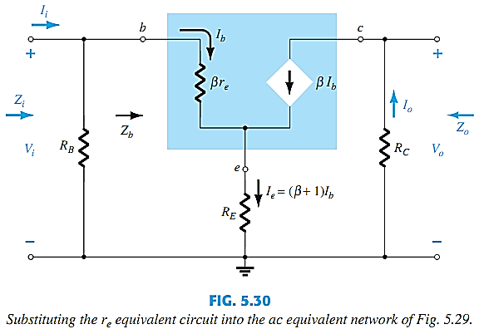
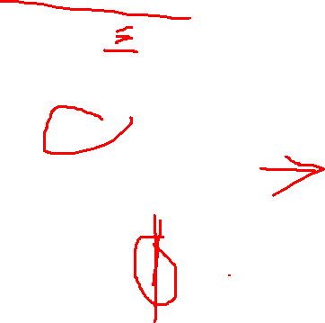
COMMON-EMITTER EMITTER-BIAS CONFIGURATION: UNBYPASSED R_{E}

Slide 7
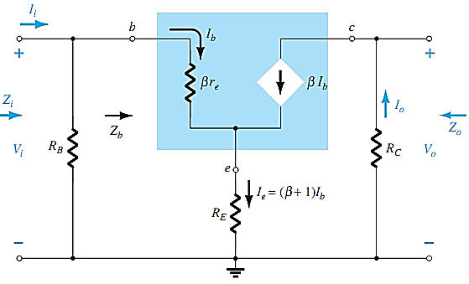



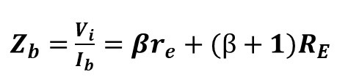
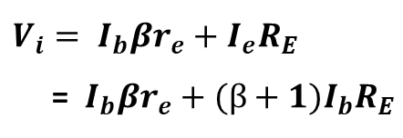

IMPEDANCE CALCULATION
INPUT IMPEDANCE, Z_{i}
$V_{i}= I_{b}βr_{e}+I_{e}R_{E}$
= $I_{b}βr_{e}+{(β+1)I}_{b}R_{E}$
$Z_{b}=$ $\frac{V_{i}}{I_{b}}=βr_{e}+{(β+1)R}_{E}$
$Z_{b}≅$ $βr_{e}+{βR}_{E}=β(r_{e}+R_{E})$
$Z_{b}≅$ ${βR}_{E} for{ R}_{E}≫r_{e}$
$Z_{i}= R_{B}||$ $Z_{b}$
OUTPUT IMPEDANCE, Z_{o}
$$Z_{o}= R_{C}$$

Slide 8






GAIN CALCULATIONS
VOLTAGE GAIN, A_{v}
$V_{o}=−I_{o}R_{C}=− βI_{b}R_{C}$ = $− β$($\frac{V_{i}}{Z_{b}}$) $R_{C}$
$A_{v}= \frac{V_{o}}{V_{i}}$ = - $\frac{βR_{C}}{Z_{b}}$
${Substituting Z}_{b}≅$ $β(r_{e}+R_{E})$
$A_{v}= \frac{V_{o}}{V_{i}}$ = - $\frac{R_{C}}{r_{e}+R_{E}}$
${For the approximation Z}_{b}≅$ $βR_{E}$
$A_{v}= \frac{V_{o}}{V_{i}}$ = - $\frac{R_{C}}{R_{E}}$
The negative sign in gain equations reveals 180° phase shift between input and output waveforms.

Slide 9
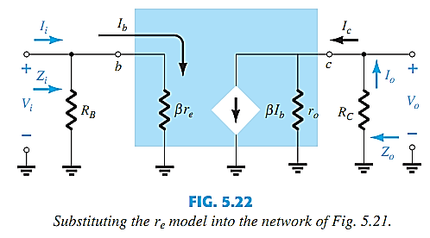
COMMON-EMITTER EMITTER-BIAS CONFIGURATION: BYPASSED R_{E}
Bypassed
If R_{E} is bypassed by an emitter capacitor C_{E}, the complete r_{e} equivalent model can be substituted, resulting in the same equivalent network as Fig. 5.22. Equations of slide no. 13 are therefore applicable.

Slide 10
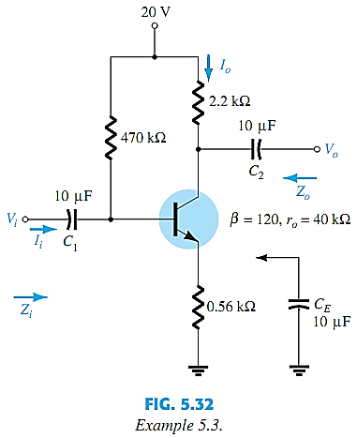
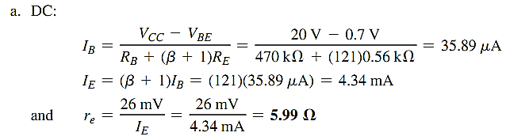
EXAMPLE
EXAMPLE 5.3: For the network of following Fig, without C_{E} (unbypassed), determine: r_{e}, Z_{i}, Z_{o} & A_{v.}

Slide 11
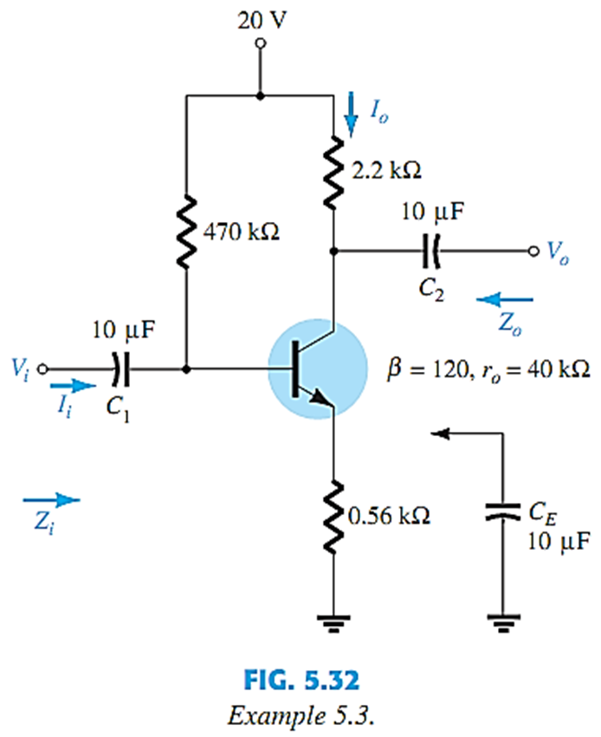
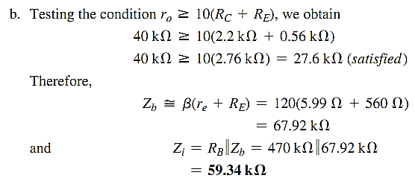
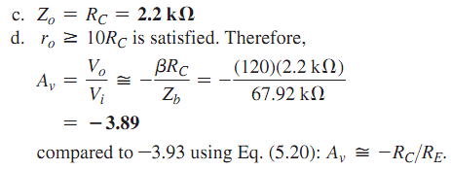
EXAMPLE Contd.

Slide 12
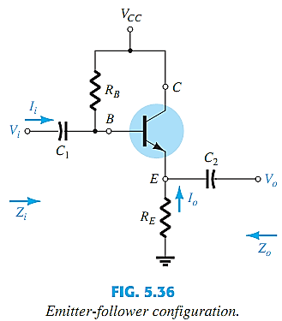
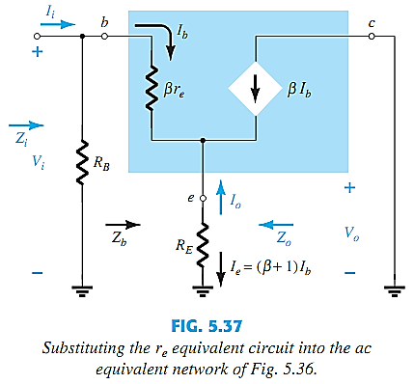
EMITTER-FOLLOWER CONFIGURATION
This is also known as the common-collector configuration.
The input is applied to the base and the output is taken from the emitter.
There is no phase shift between input and output.

Slide 13
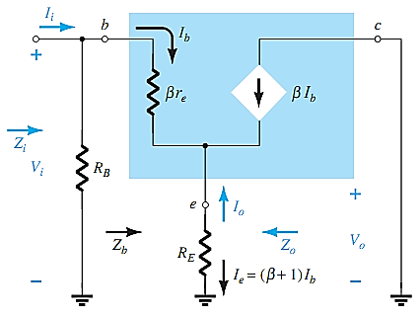




IMPEDANCE CALCULATIONS
INPUT IMPEDANCE, Z_{i}
$Z_{i}= R_{B}||$ $Z_{b}$
$$Z_{b}=βr_{e}+{(β+1)R}_{E}$$
$Z_{b}≅$ $β(r_{e}+R_{E})$
$Z_{b}≅$ ${βR}_{E} for{ R}_{E}≫r_{e}$

Slide 14
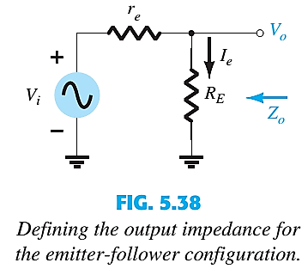

IMPEDANCE CALCULATIONS
OUTPUT IMPEDANCE, Z_{o}
$$I_{b}= \frac{V_{i}}{Z_{b}} ,$$
$$I_{E}=\left(β+1\right)I_{b}=\left(β+1\right)\frac{V_{i}}{Z_{b}}$$
$$I_{E}= \frac{\left(β+1\right)V_{i}}{βr_{e}+{(β+1)R}_{E}}$$
$Since (β+1)$ $≅ β$
$$I_{E}= \frac{V_{i}}{r_{e}+R_{E}}$$
$$To determine Z_{o},{ V}_{i} is set to zero$$
$Z_{o}$= $R_{E}$|| $r_{e}$ $Z_{o}$= $r_{e}$ |$R_{E}$ $≫r_{e}$

Slide 15




GAIN CALCULATIONS
VOLTAGE GAIN, A_{v}
$$V_{o}=I_{e}R_{E}=\left(β+1\right)I_{b}R_{E}=\frac{V_{i}\left(β+1\right)R_{E}}{Z_{b}}$$
$when r_{o}≥10R_{E}$ and $β+1≅β$
$$But Z_{b}≅β(r_{e}+R_{E})$$
$$A_{v}=\frac{V_{o}}{V_{i}}≅\frac{βR_{E}}{β(r_{e}+R_{E})}≅\frac{R_{E}}{(r_{e}+R_{E})}$$
See Example 5.7

Slide 16
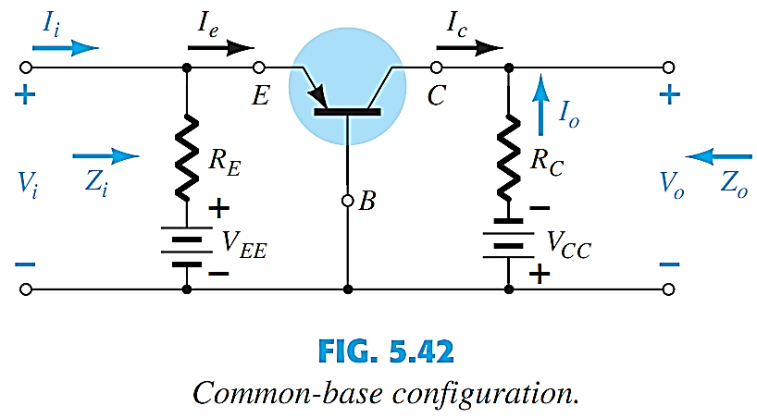
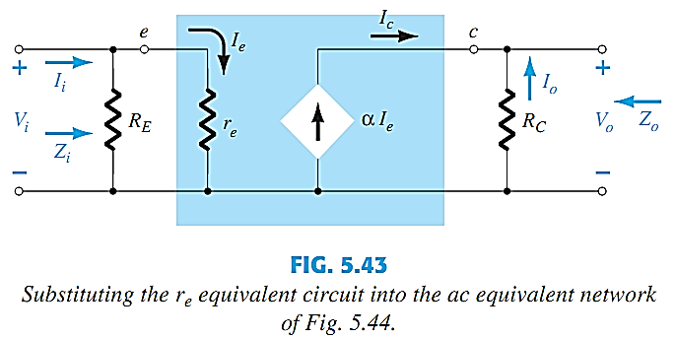
COMMON-BASE CONFIGURATION
The input is applied to the emitter.
The output is taken from the collector.
Low input impedance.
High output impedance.
Very high voltage gain.
No phase shift between input and output.

Slide 17
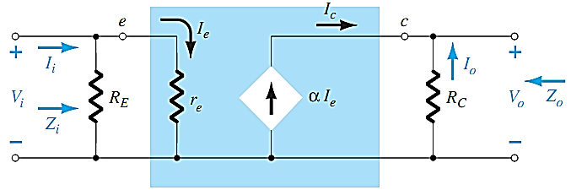

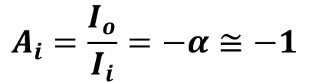








CALCULATIONS
INPUT IMPEDANCE, Z_{i}
$Z_{i}= R_{E}‖$ $r_{e}$
OUTPUT IMPEDANCE, Z_{o}
$$Z_{o}= R_{C}$$
CURRENT GAIN, A_{i}
VOLTAGE GAIN, A_{v}
$Assuming R_{E}≫$ $r_{e}$
$$I_{e}= \frac{V_{i}}{r_{e}}$$
$I_{e}=$ $I_{i}$
$V_{o}= {−I_{o}R}_{C} =−{\left(I_{C}\right)R}_{C}=α{I_{e}R}_{C}$ ;
$I_{o}=−$ $αI_{e}=−$ $αI_{i}$
$V_{o}= α \left(\frac{V_{i}}{r_{e}}\right)R_{C}$ ;
$A_{v}= \frac{V_{o}}{V_{i}}$ = $\frac{{ αR}_{C}}{r_{e}}≅\frac{{ R}_{C}}{r_{e}}$
$$A_{i}=\frac{I_{o}}{I_{i}}=−α≅−1$$

Slide 18
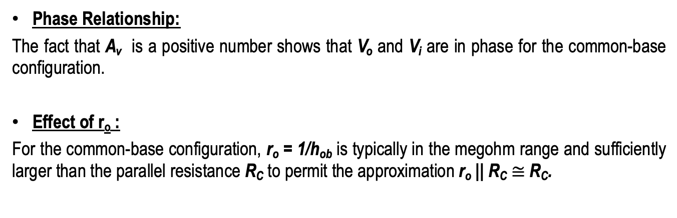
COMMON-BASE CONFIGURATION
Phase Relationship:
The fact that A_{v} is a positive number shows that V_{o} and V_{i} are in phase for the common-base configuration.
Effect of r_{o} :
For the common-base configuration, r_{o} = 1/h_{ob} is typically in the megohm range and sufficiently larger than the parallel resistance R_{C} to permit the approximation r_{o} || R_{C} $≅$R_{C}.

Slide 19
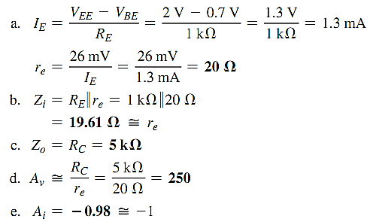
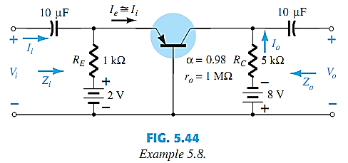
EXAMPLE
EXAMPLE 5.8: For the network of following figure, determine: r_{e}, Z_{i}, Z_{o}, A_{v}, A_{i}.

Slide 20
End of Lecture-2

